Slide 1
Building Open-Source Tools for Safety Monitoring Advancing Research Through Community Collaboration
Jeremy Wildfire
jwildfire@gilead.com Presented on Behalf of the Interactive Safety Graphics Working Group
Notes:
As of 2/21/2020

Slide 2

Interactive Safety Graphics (ISG) Working Group
Sub-team of DIA & ASA-Biopharm Safety Working Group
https://safetygraphics.github.io/

Slide 3
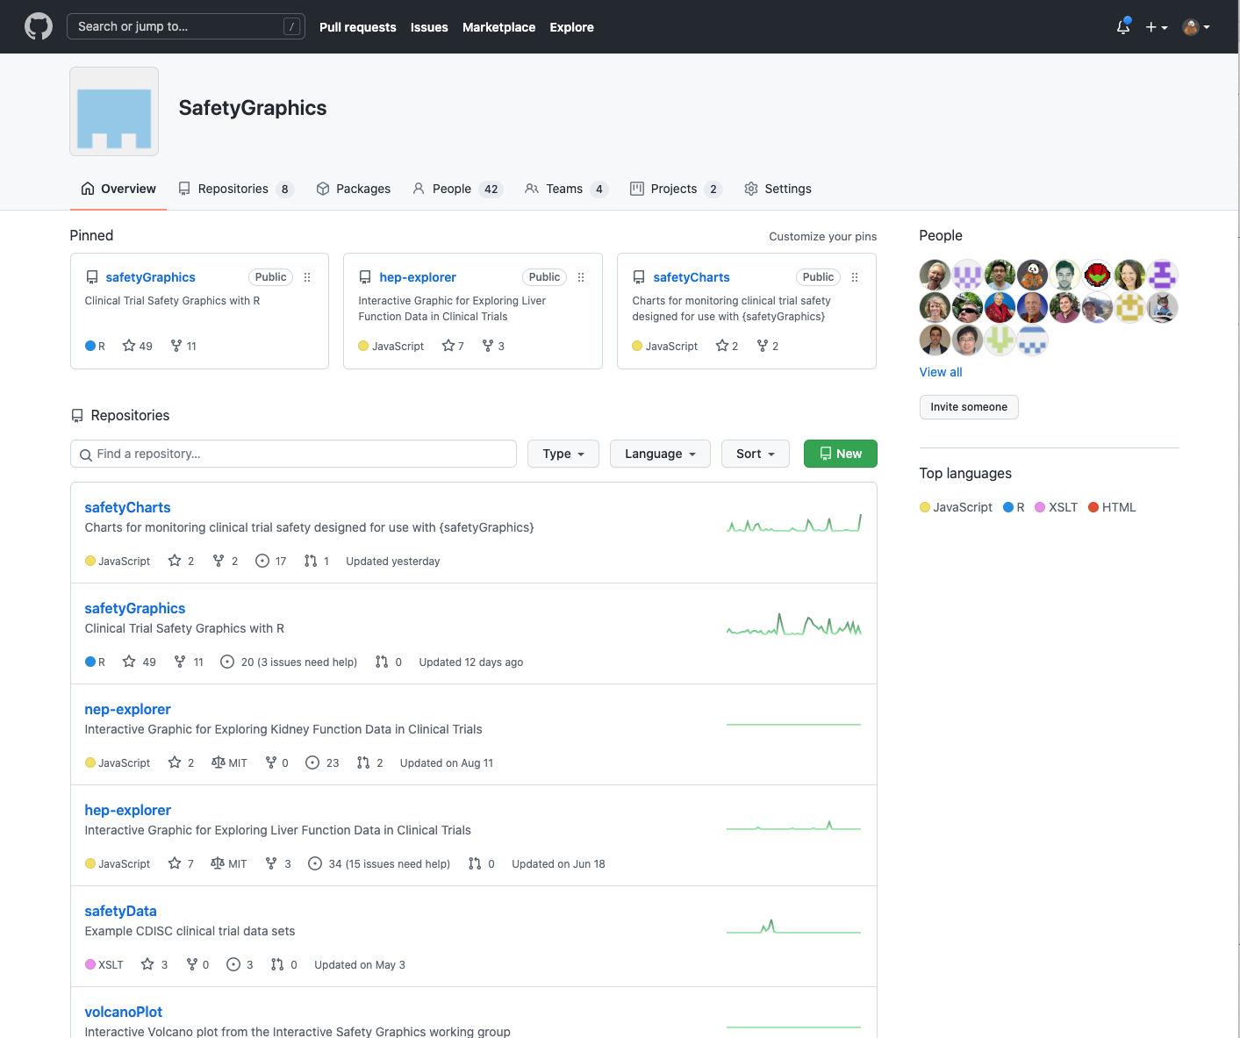
https://www.github.com/safetyGraphics

Slide 4
safetyGraphics
An open source framework for evaluation of clinical trial safety
Links: CRAN | GitHub | Demo
Initialize App:
install.packages('safetyGraphics’)
library(safetyGraphics)
safetyGraphicsApp()

Slide 5
Moving from Static to Interactive
Phase 0
2012-2018
Phase 1
2018-2019
Establishing an Open-Source Working group
Building a Robust Technical Framework
Phase 2
2019-2021
Interactive Safety Graphics WG
We are here
Phase 3
2021-???
Building Production Workflows

Slide 6
Phase 0: 2012-2018 Moving from Static to Interactive

Slide 7
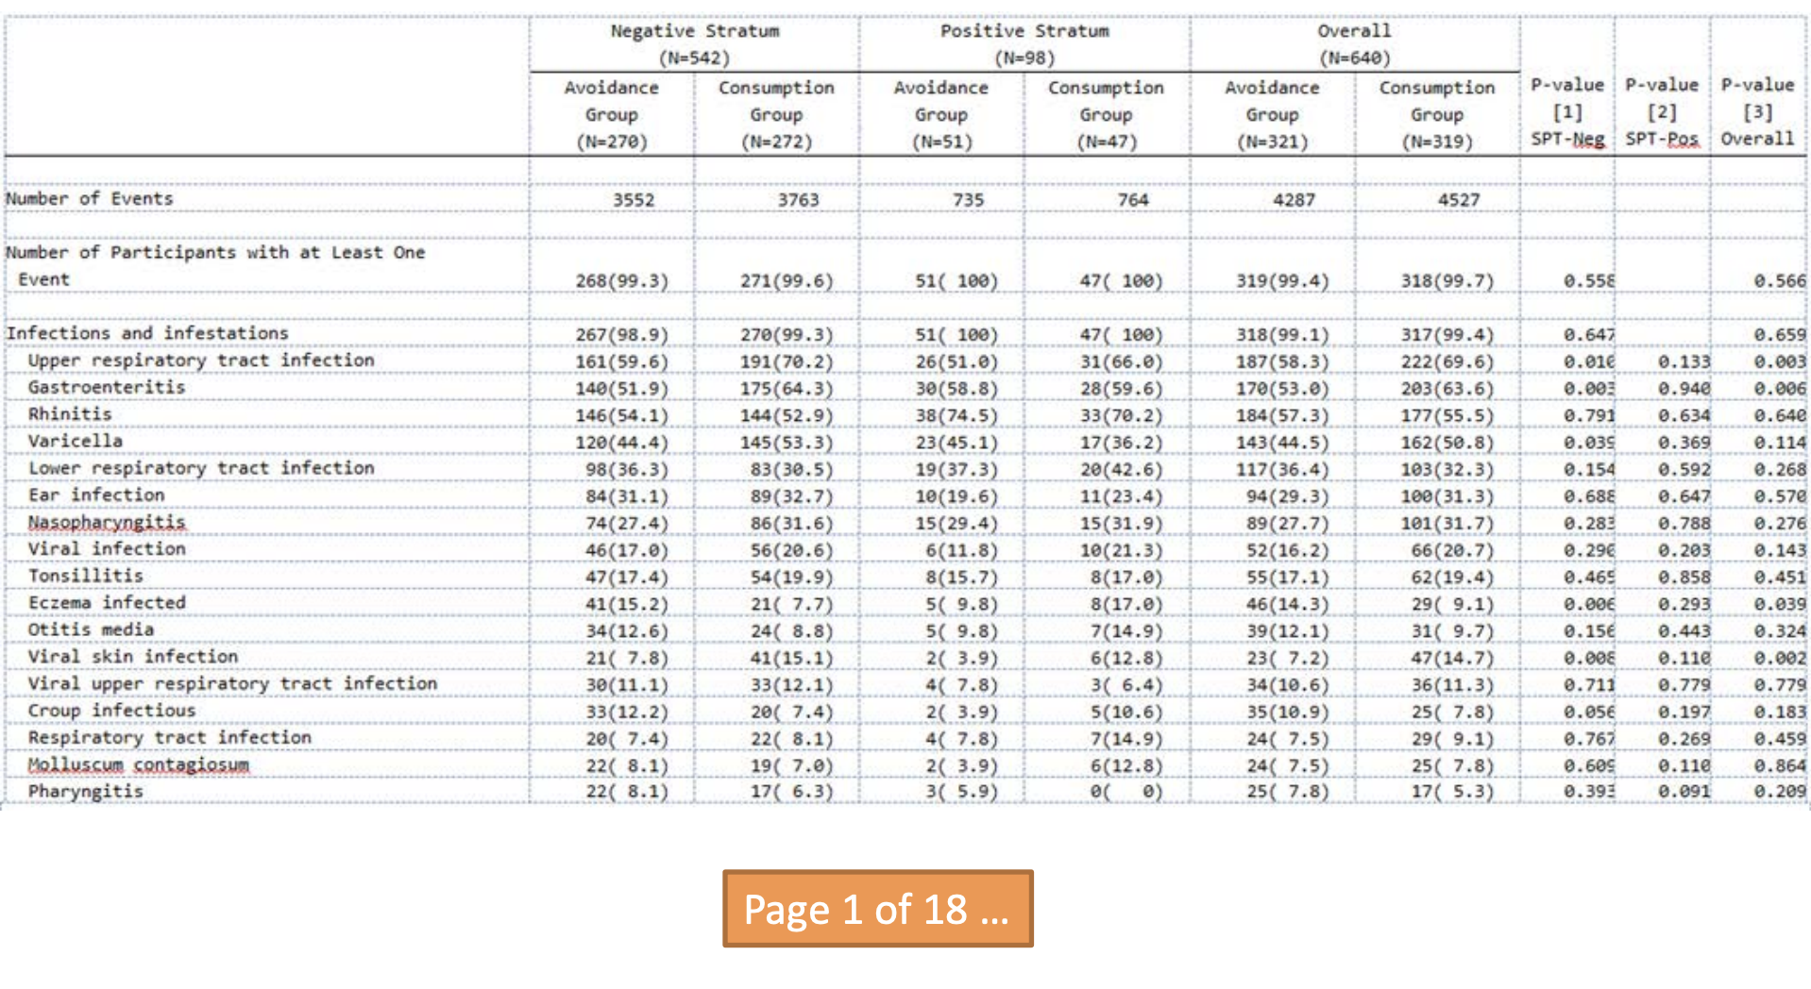

Slide 8
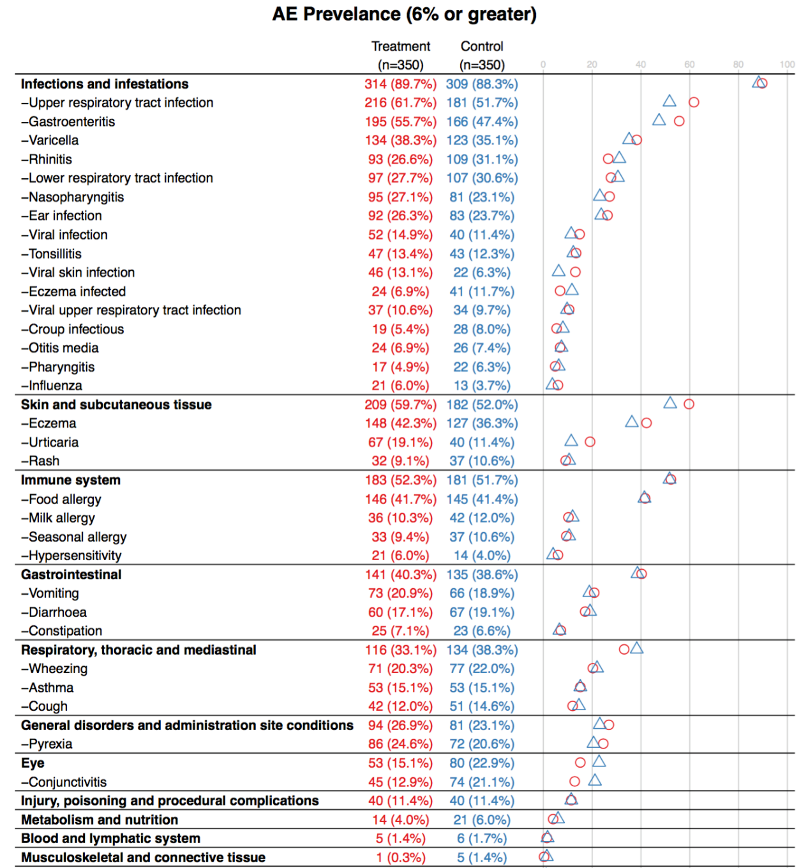
rhoinc/aedotplot()
Inspired by Frank Harrell’s HH::ae.dotplot()

Slide 9
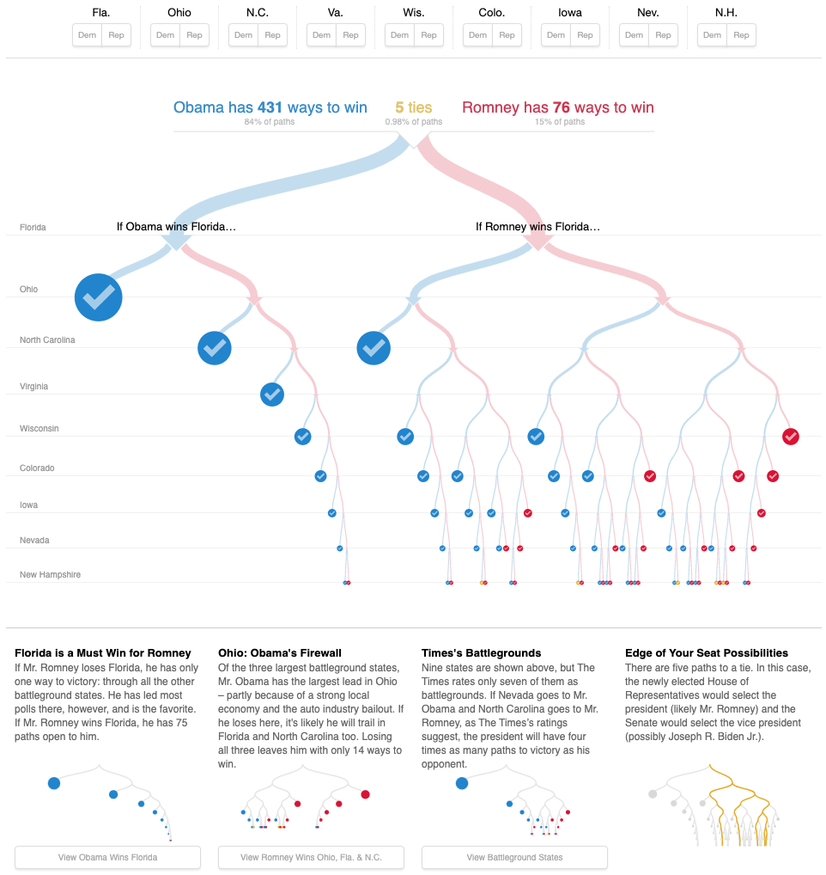
512 Paths to the White House
NY Times 2012

Slide 10
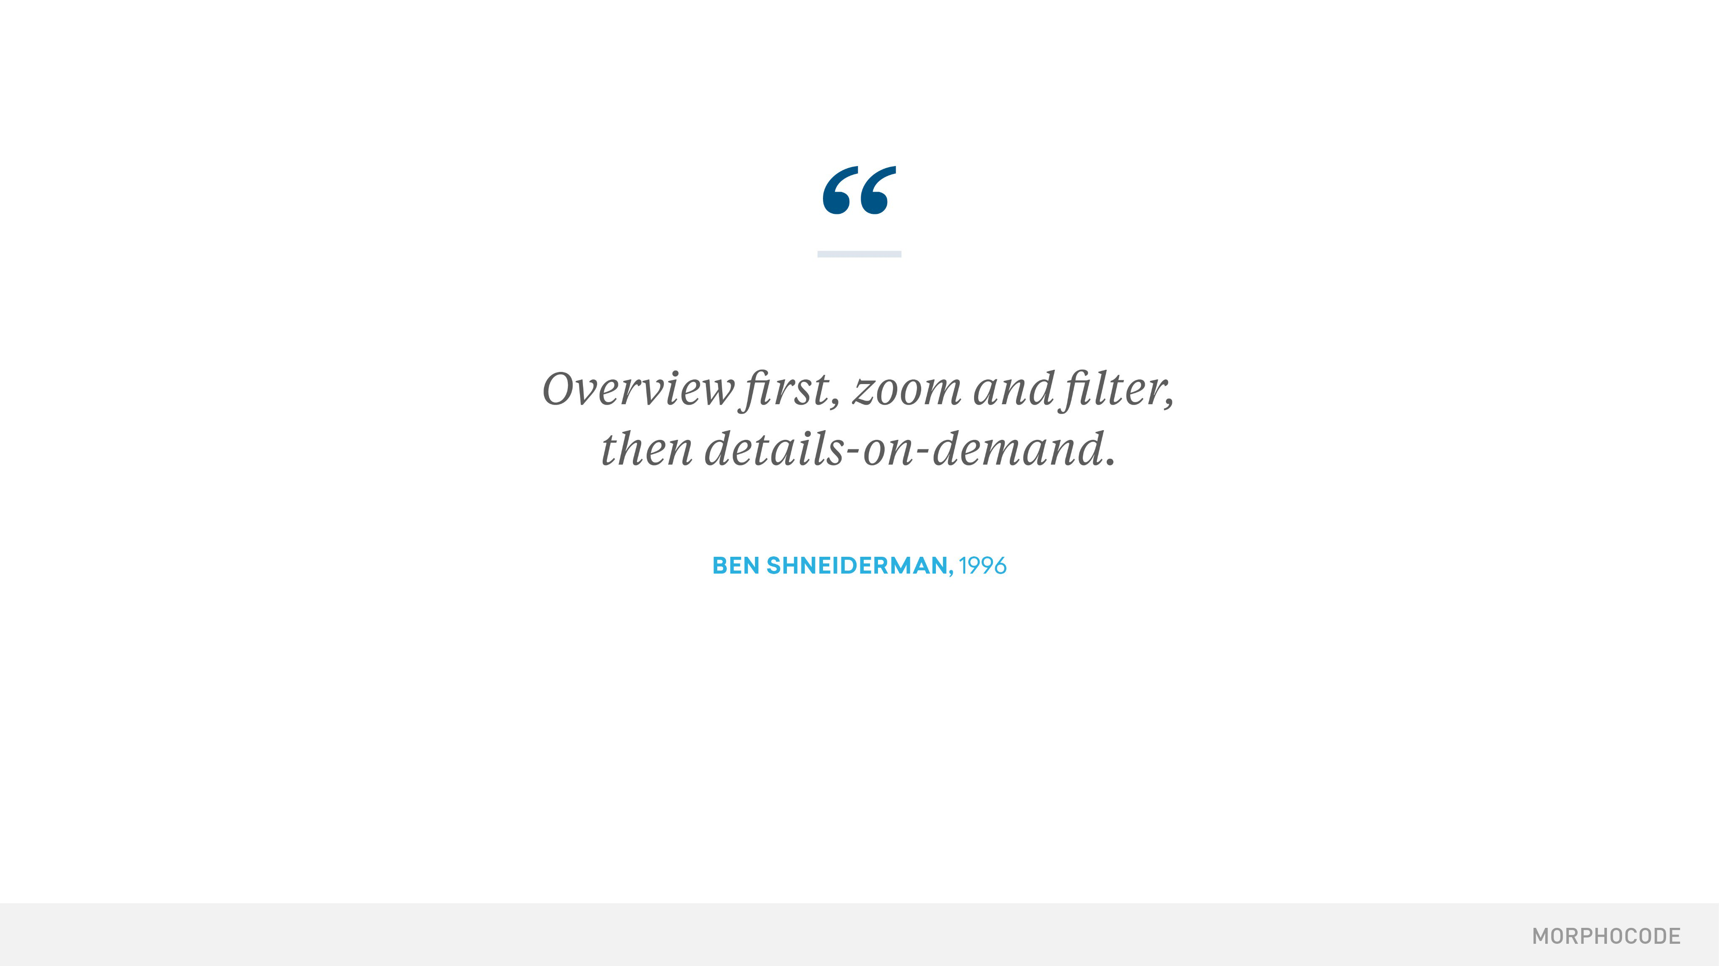

Slide 11
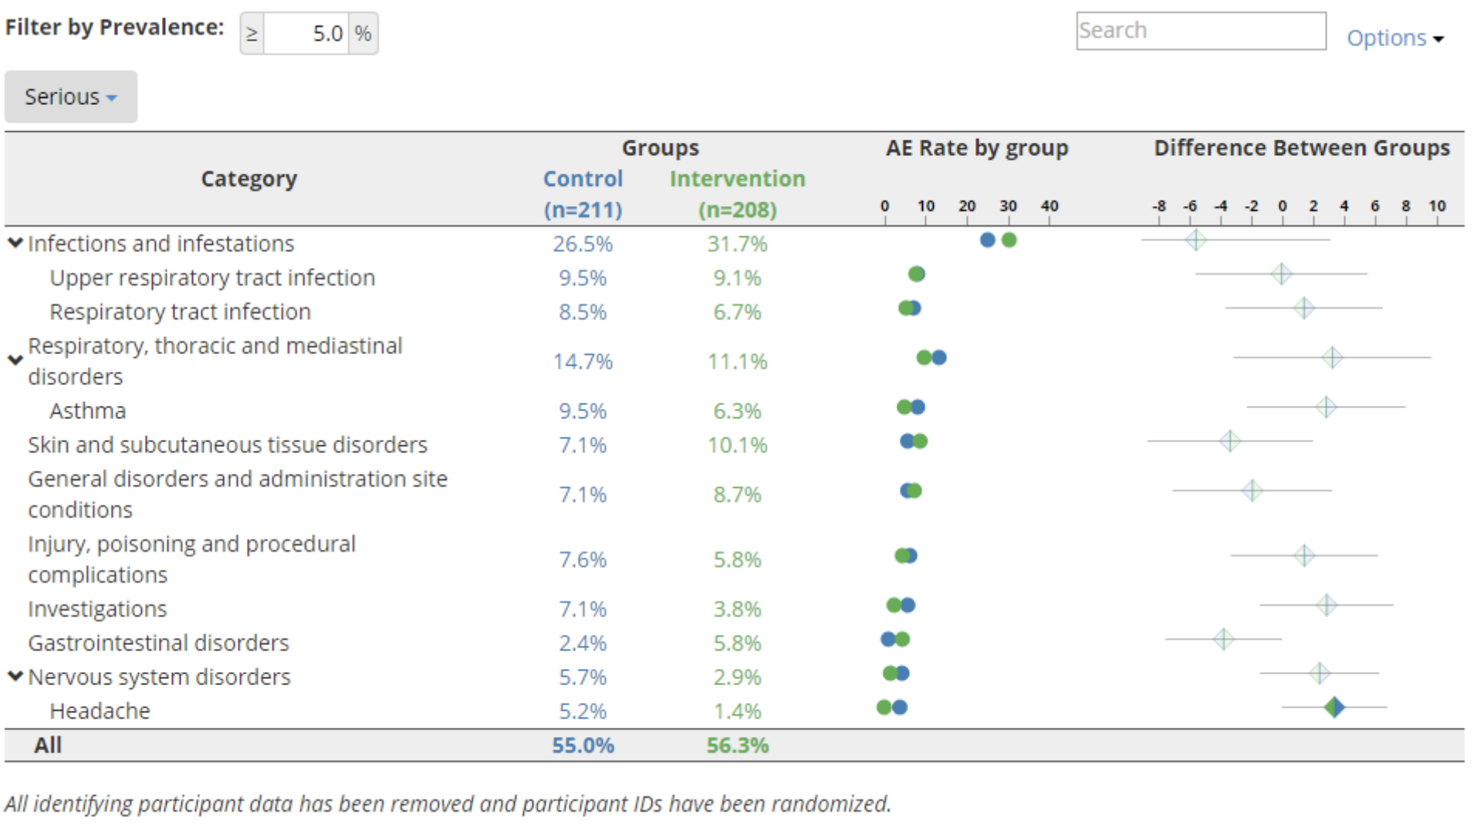
Adverse Event Explorer
Demo - Repo

Slide 12
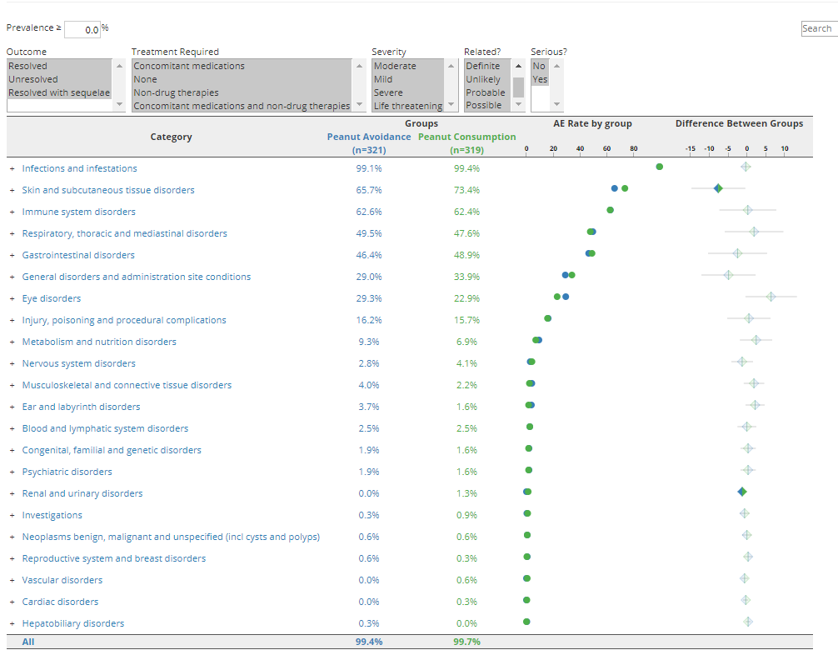
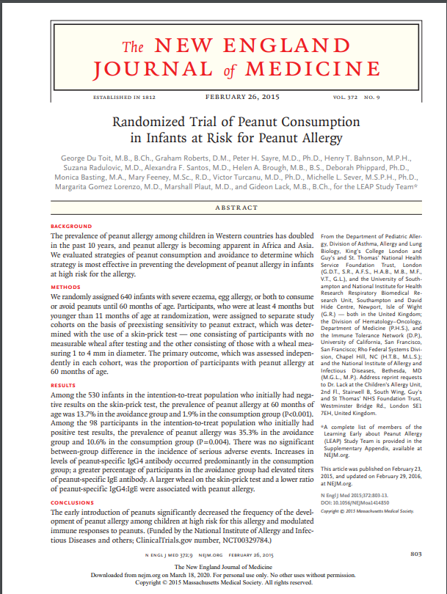
Randomized Trial of Peanut Consumption in Infants at Risk for Peanut Allergy. Du Toit et al. 2015.
Paper - AE Explorer

Slide 13
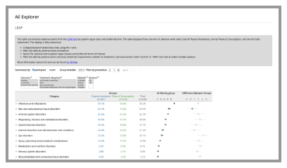
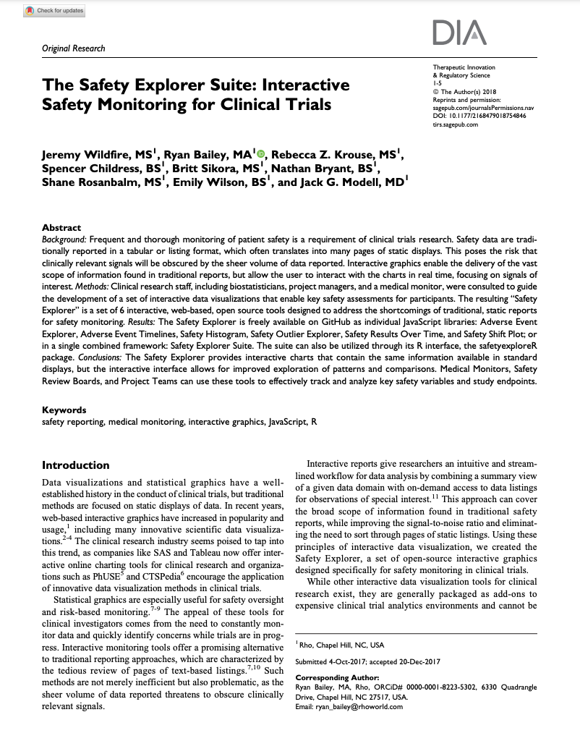
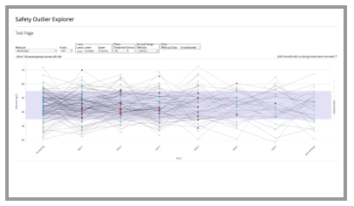
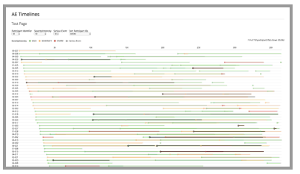
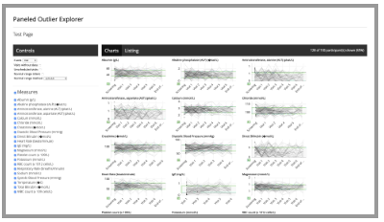
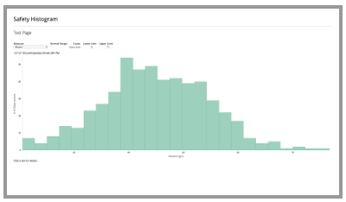
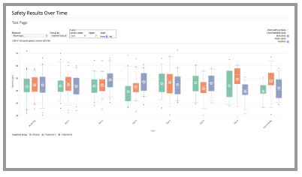
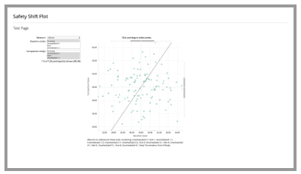
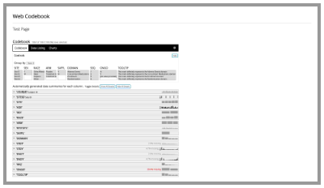
The Safety Explorer Suite: Interactive Safety Monitoring for Clinical Trials, Wildfire et al. 2018
Paper - Repo

Slide 14
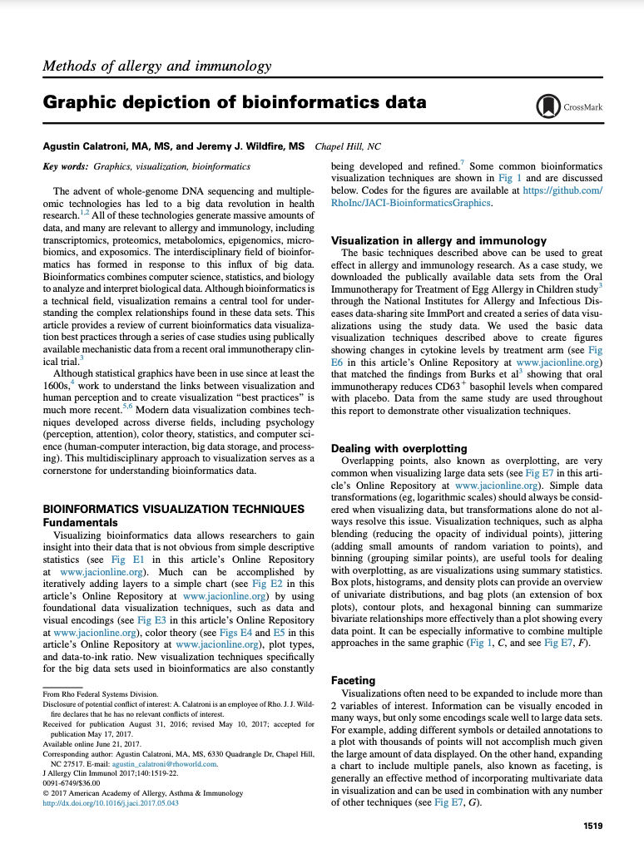
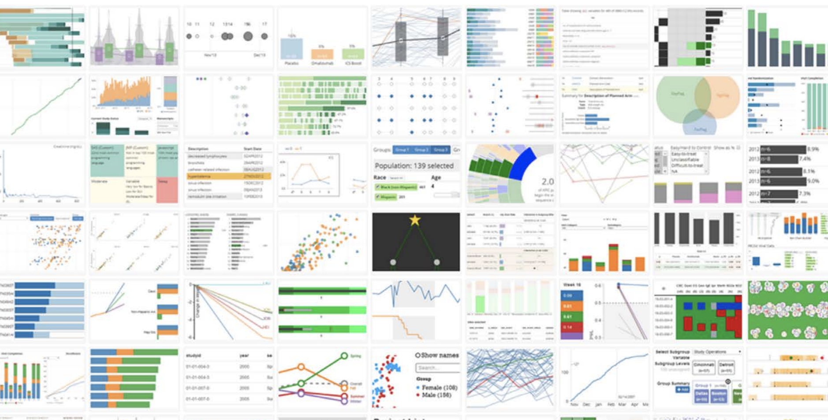
Show collage?
Graphic Depecition of Bioinformatics Data. Calatroni & Wildfire 2017
Paper - Repo

Slide 15
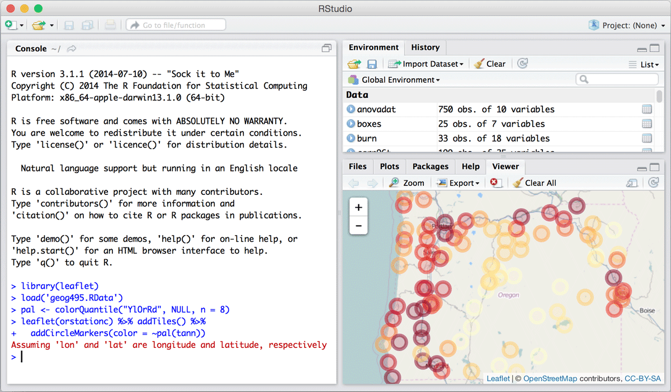


d3 v3 Released June 2013
Shiny v1 Released June 2017
Htmlwidgets v1 Released Jan 2018
Notes:
Technology for Visual Analytics changed rapidly
d3.js allows for incredible flexibility. v3 release June 2013.
New R tools for Interactive Graphics released.
{shiny} v1.0 release Jan 2017
{htmlwidgets} v1.0 release Jan 2018
Minimal Open-Source collaboration in Pharma
Growing Data Science Presence in Pharma

Slide 16




Web-based
Interactive Graphic
Data
JSON Settings
Web Magic
+
+
=

Slide 17
+
+
=
+
+
=
+
+
=
+
+
=
+
+
=
+
+
=
+
+
=
+
+
=

Slide 18
Phase 1: 2018-2019 Establishing an Open-Source Working group

Slide 19



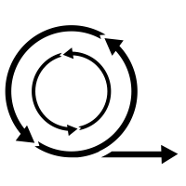


ISG Guiding Principles
Open Source
Highly Collaborative
Interactive
Easy to use
Data Standard Compliant
Agile
Engaging
Notes:
Open Source - Transparent. Customizable. Free!
Highly Collaborative - Clinicians and Programmers working together.
Interactive - Users can explore their data.
Easy to Use - Just open up a webpage.
Easy to Configure - Streamlined configuration with R.
Compliant with Data Standards - Support ADaM and SDTM by default.
Agile - Frequent releases with GitHub.
Engaging - Regular Feedback from users. Pilot testing. Open issue tracking.

Slide 20
Across Companies
Across Functional Areas
Across Technologies
Across Biotech Sectors
With Regulators

Slide 21
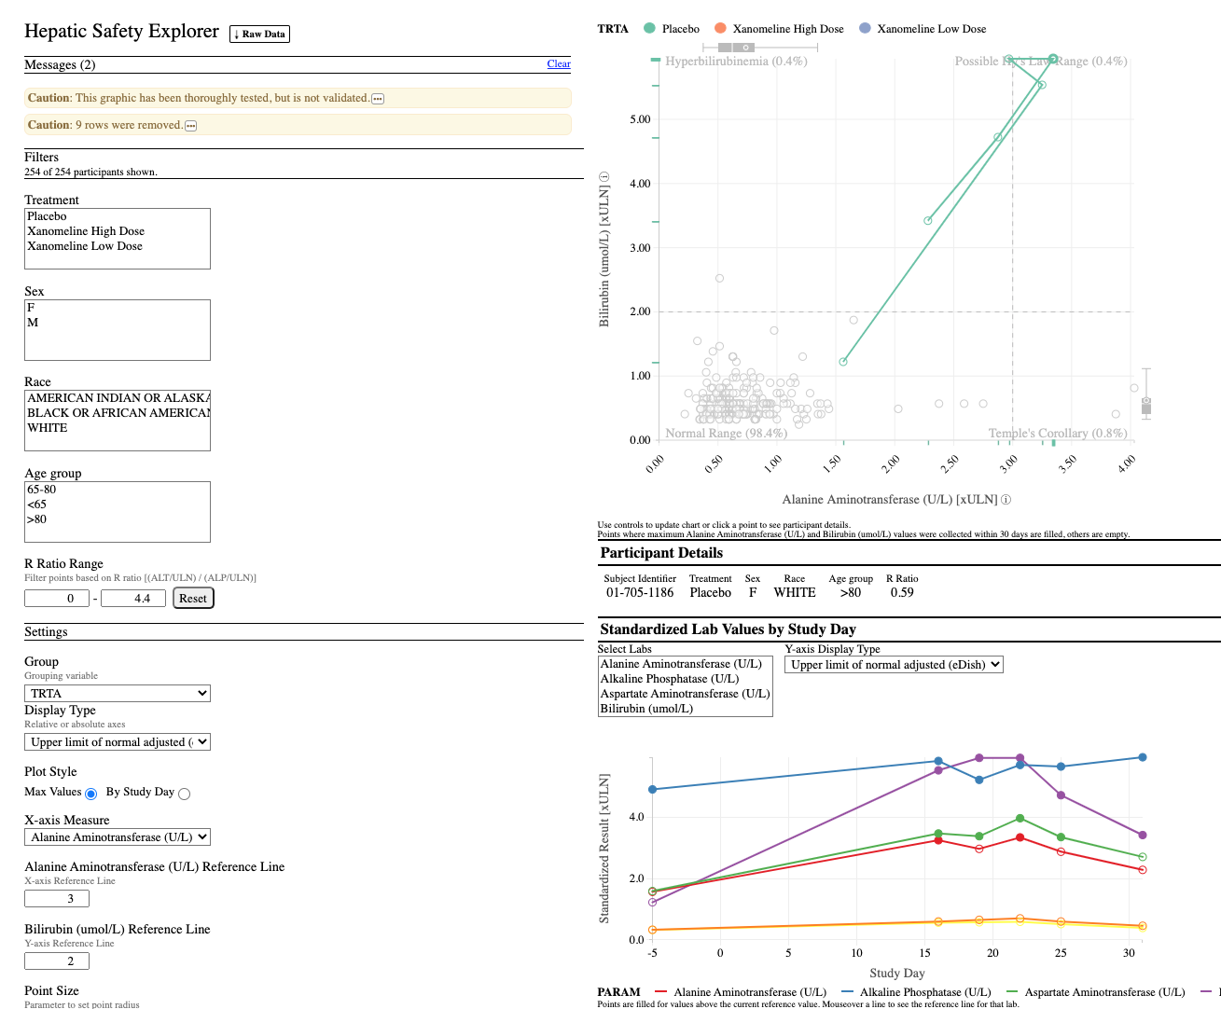
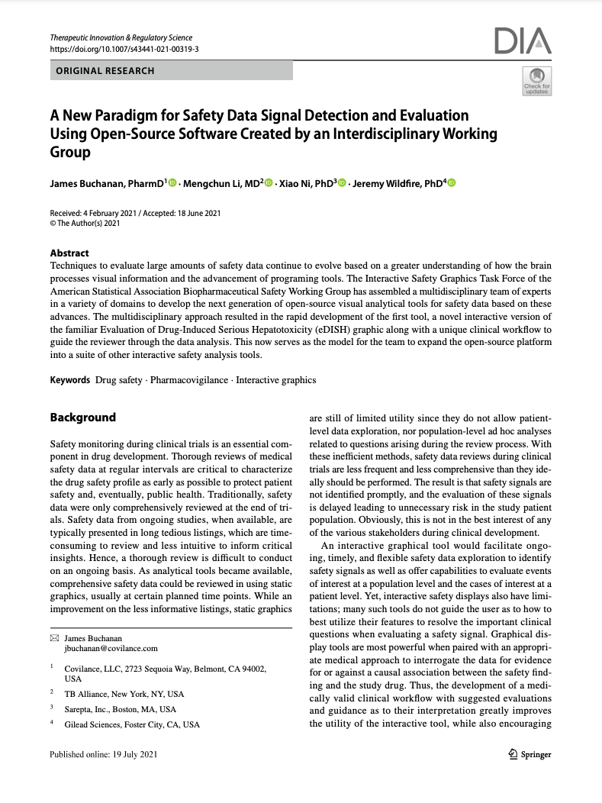
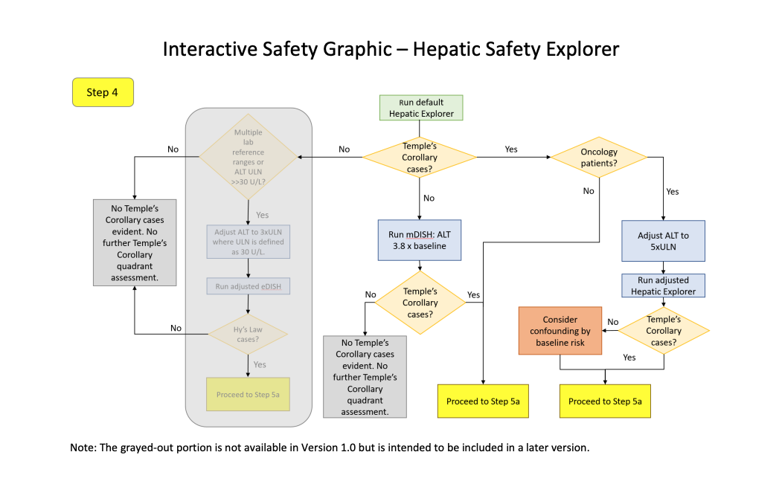
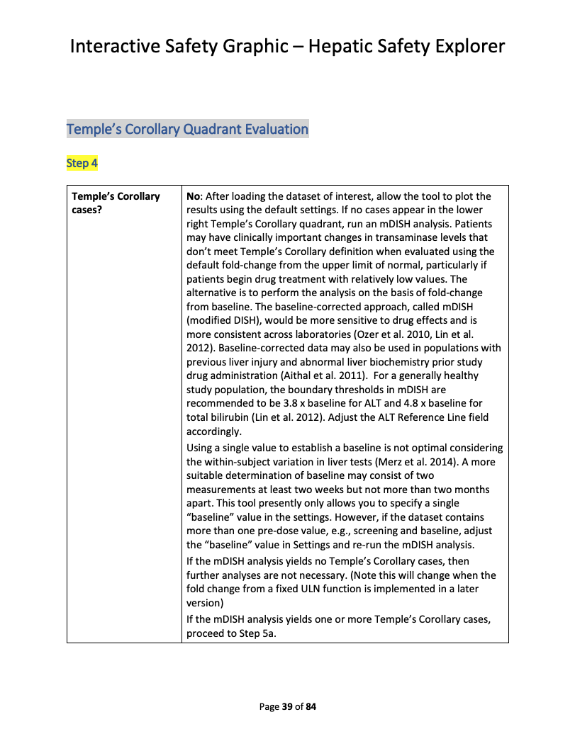
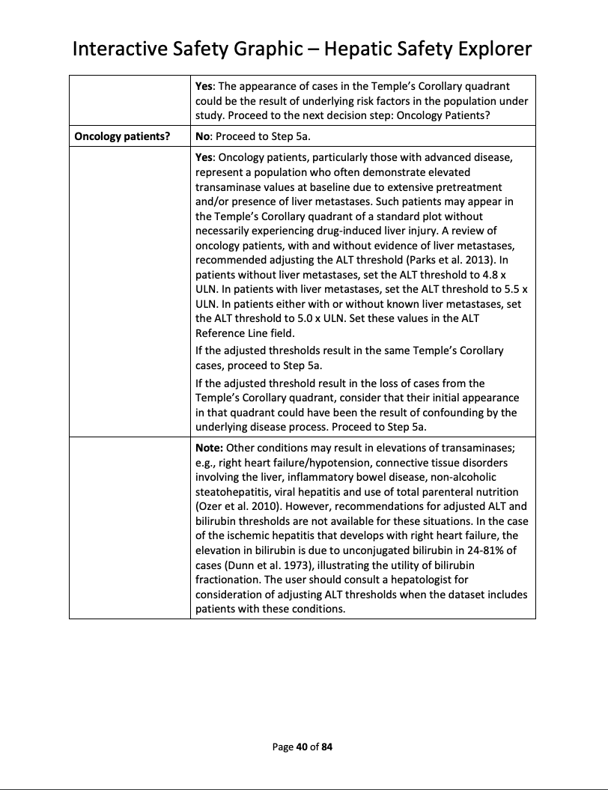
Hepatic Safety Explorer
Demo – Repo – Clinical Workflow – Paper

Slide 22

That’s nice! How do I use it?

Slide 23
safetyGraphics
An open-source framework for evaluation of clinical trial safety
Links: CRAN | GitHub | Demo

Slide 24
Version 1
Interactive Graphic
webpage
Lab Data
Other Data Domains

Slide 25


safetyGraphics Pilot Tests
Notes:
FDA, Merck, Novartis, BI, Bayer, Abbvie, Lilly, J&J, Rho

Slide 26
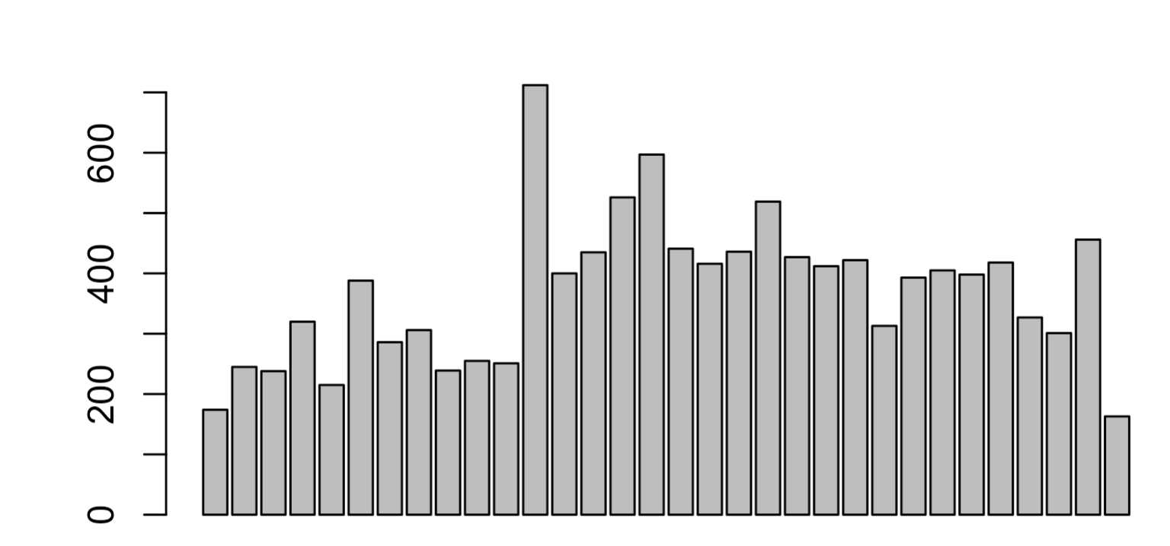
>12k Downloads
2019-02
Monthly Downloads
2021-09
Notes:
V1.0 Pilot tested in a broad pharma setting
Tested by 9 organizations: FDA, Merck, Novartis, BI, Bayer, Abbvie, Lilly, J&J, Rho
All users reported that the tool met or exceeded expectations
None found it difficult to upload data using the R package
~50 specific comments / requests
Several teams working on pilot deployments
Collaboration with FDA
Active participation in working group
Presented at FDA Innovation Forum

Slide 27





Medical Monitoring
Data Exploration
Data Monitoring Committee
Risk-Based Monitoring?
Regulatory Submissions??
Notes:
Medical Monitoring
Data Exploration – Supplemental tool for analysts.
Data Monitoring Committee - Novartis submitted graphics to DMC.
Risk-based Monitoring?
Regulatory Submissions???
Lots of discussion here. Several other working groups piloting interactive submissions.

Slide 28
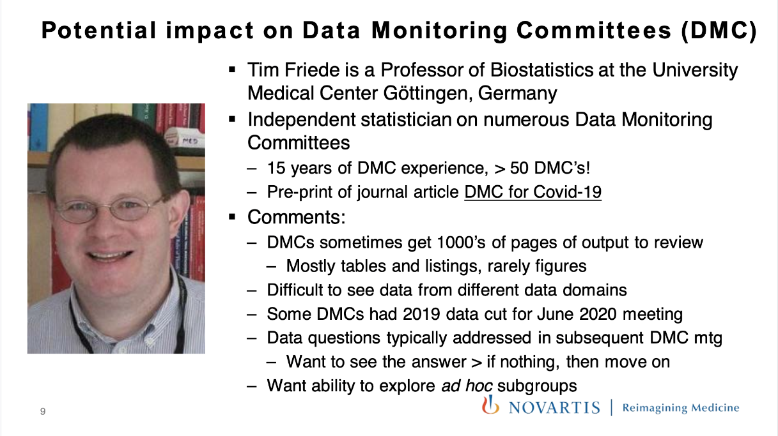
Use Case: Novartis DMC
From Doug Robinson (Novartis)
2020 R in Pharma Keynote

Slide 29
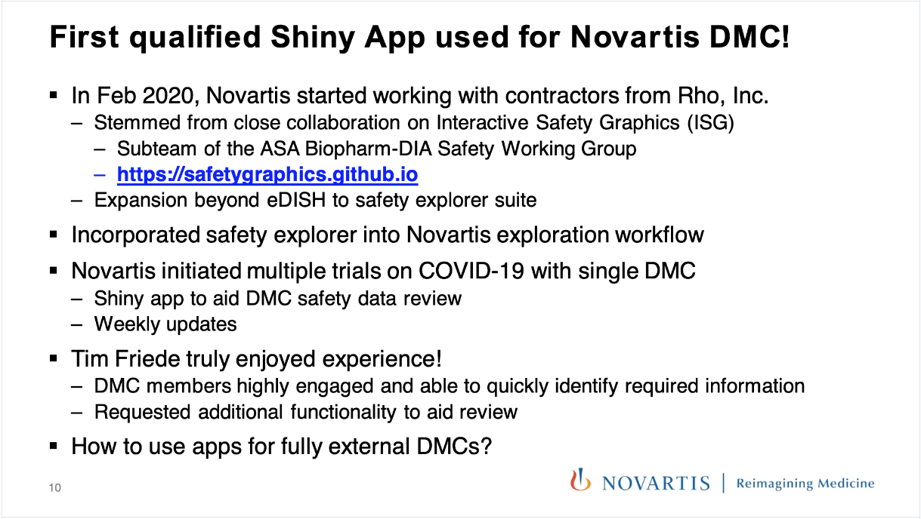
Use Case: Novartis DMC
From Doug Robinson (Novartis)
2020 R in Pharma Keynote

Slide 30
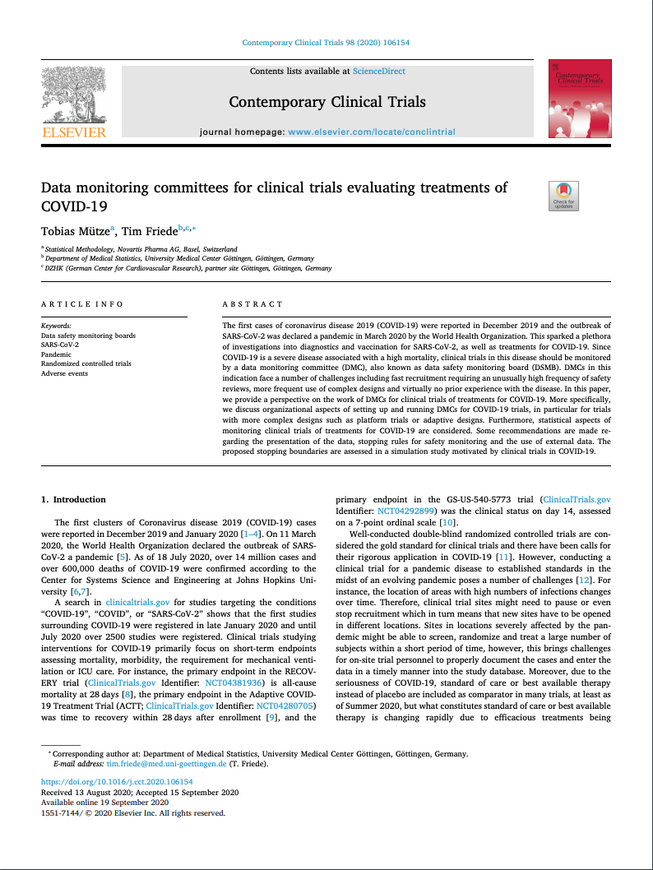
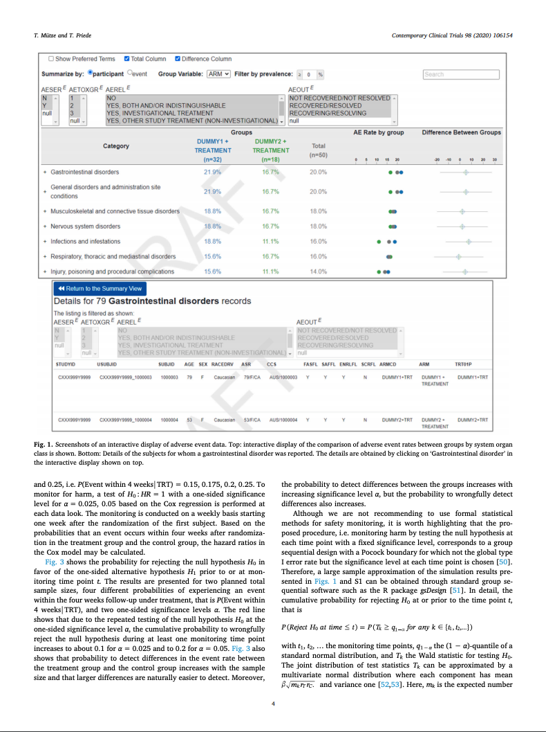
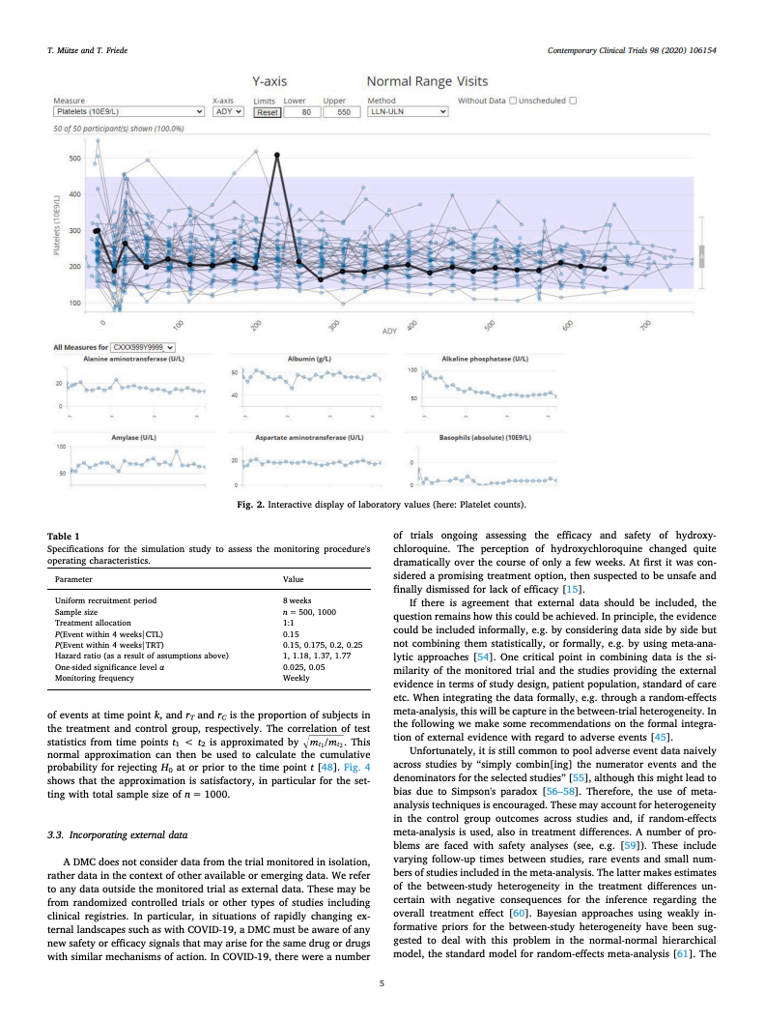
Use Case: Novartis DMC
Data Monitoring committees for clinical trials evaluating treatments of COVID-19. Tobias Mütze and Tim Friede. 2020 - Paper

Slide 31
Phase 2: 2019-2021 Improving The Technical Framework

Slide 32
{safetyGraphics} v1.0 - Lessons Learned
Lab Data only
HTML Widgets only
Adding New Charts
Testing in Shiny
- Saving Customizations
Use R For Data Load/Config
Shared Data and Settings
Flexible data standards
Modular Shiny Framework
Exported HTML Reports
What Worked
Updates Needed

Slide 33

Version 2

Slide 34


Version 2

Slide 35
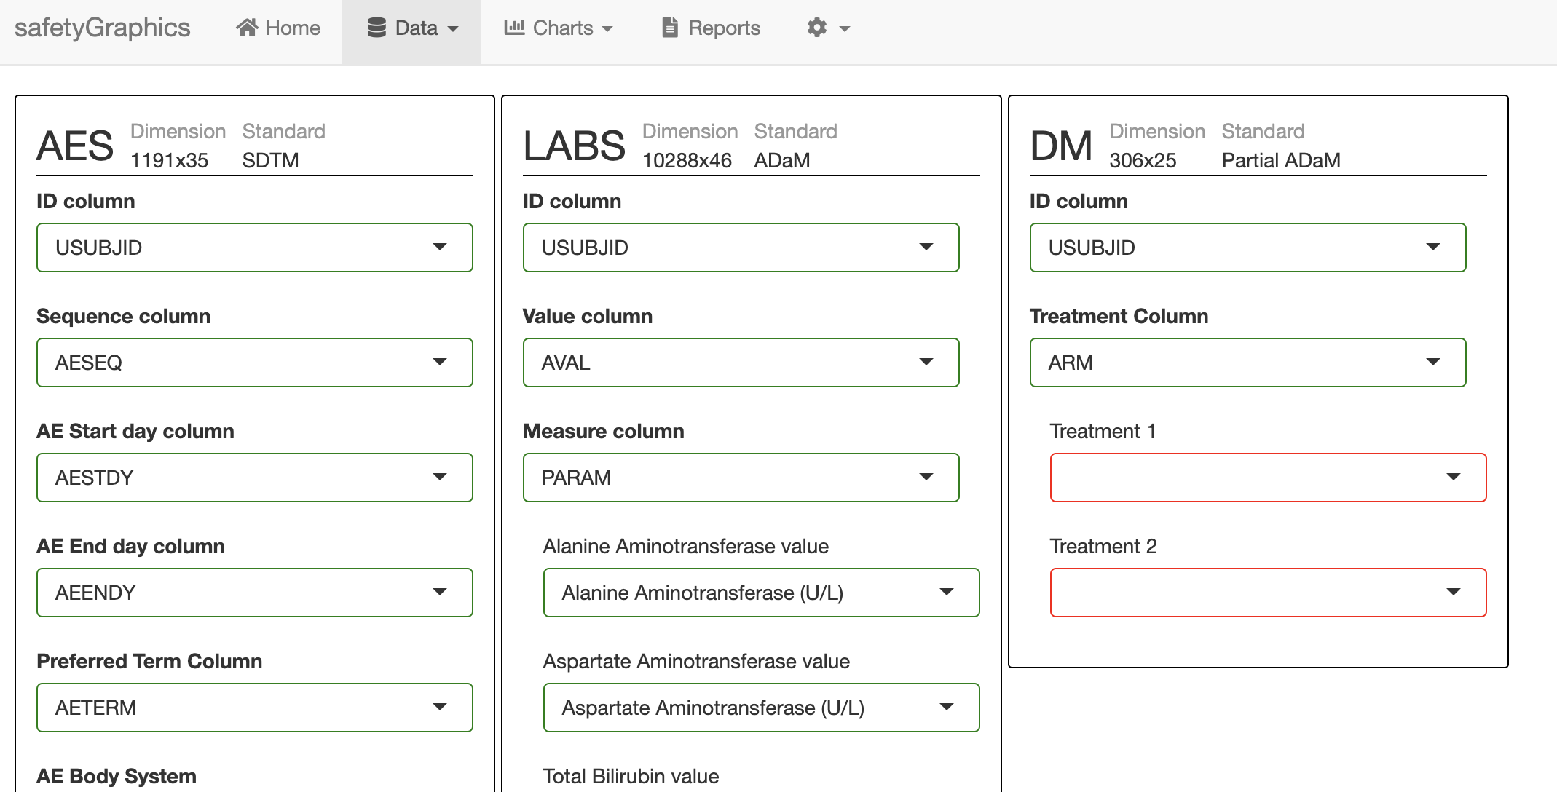
safetyGraphics 2.0 Multiple Data Domains
V2

Slide 36
safetyGraphics 2.0 Multiple Data Domains
Load Data
Configure Settings
Explore Charts
Export Report
v1
Mapping
Domain1
Column1
Domain1
Column1
Select1 (col)
Domain2
Column2
Select2 (field)
Domain3
Column3
Select3 (field)
v2

Slide 37
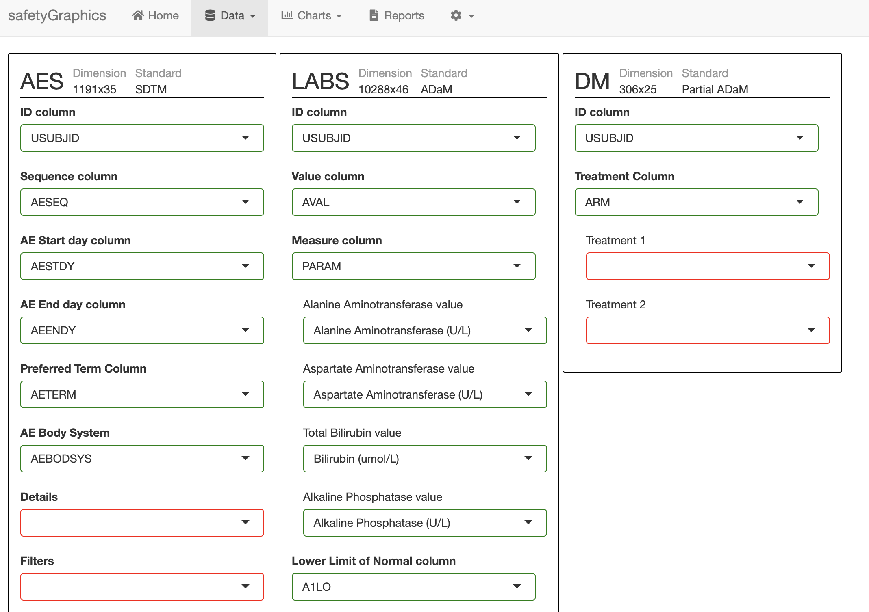
safetyGraphics 2.0 Multiple Data Domains
1 Mapping Tab Module

Slide 38
safetyGraphics 2.0 Multiple Data Domains
3 Domain Modules

Slide 39
safetyGraphics 2.0 Multiple Data Domains
14 Column Modules

Slide 40
safetyGraphics 2.0 Multiple Data Domains
20 Select Modules

Slide 41
Shiny App
# Start safetyGraphics Shiny App with custom charts
safetyGraphicsApp(charts=myCharts)
myCharts list()
# Make list of all charts in specific location
# Specify ‘path’ or ‘package’ - ‘safetyCharts’ = default
myCharts<-makeChartConfig()
aeExplorer
list(…)
outlierModule
list(…)
…
newChart
list(…)
myCharts$newChart list()
name
‘newChart’
domain
‘labs’
type
‘htmlwidget’
# Add a Single Chart (usually saved as yaml)
# Automatically called for yaml in ‘path’/‘package’
myCharts$newChart<-read_yaml(path)
workflow
list(…)
functions
list(…)
myCharts$newChart$functions list()
# Bind list of functions to a chart
# Specified by chart$workflow, chart$type & chart$package
# Automatically called for yaml in ‘path’/‘package’
myCharts$newChart<-prepareChart(myCharts$newChart)
ui
function()
server
function()
init
function()
main
function(data, settings)
data
list(df1,df2,…)
settings
list(list1,list2,…)
# Data and Setting inputs used in main() and init()
# reactive() in shiny app, but not in exported code.

Slide 42
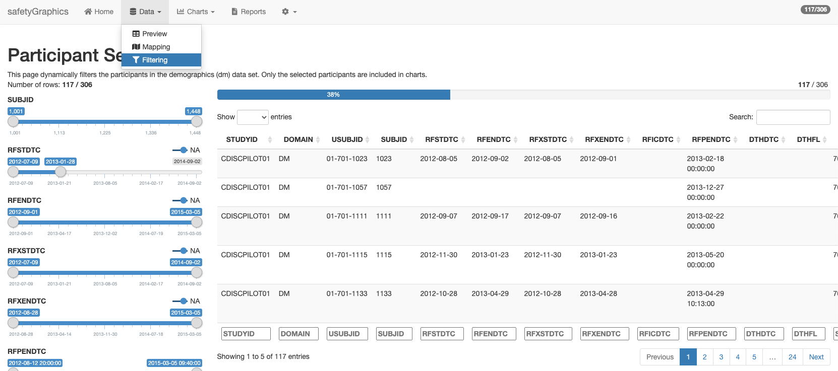
safetyGraphics 2.0 Shared Population Filters
Shared Population filters with {esquisse} package

Slide 43
Version 1
Interactive Graphic
webpage
Lab Data
Other Data Domains

Slide 44

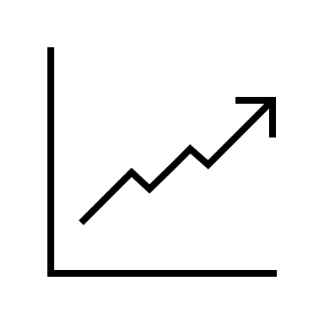


Version 2
Interactive Graphics
Domain Data

Slide 45
Phase 3: 2021 and beyond Move towards a Production Framework

Slide 46
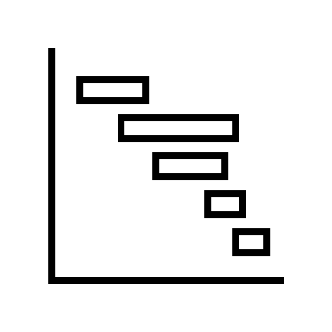
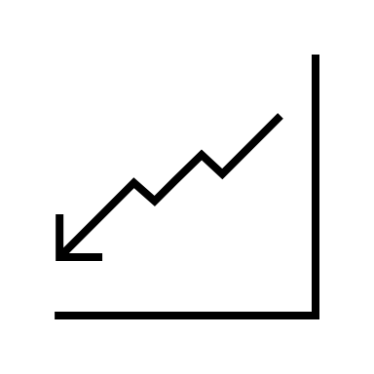

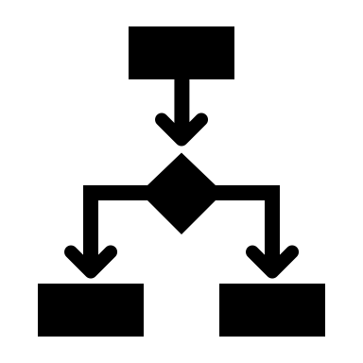



New Charts
Qualification
Deployment
Notes:
More Charts - Expand Chart Coverage to new safety domains
Qualification – Create Qualification Guidelines
Deployment – Run Pilots with interested stakeholders

Slide 47
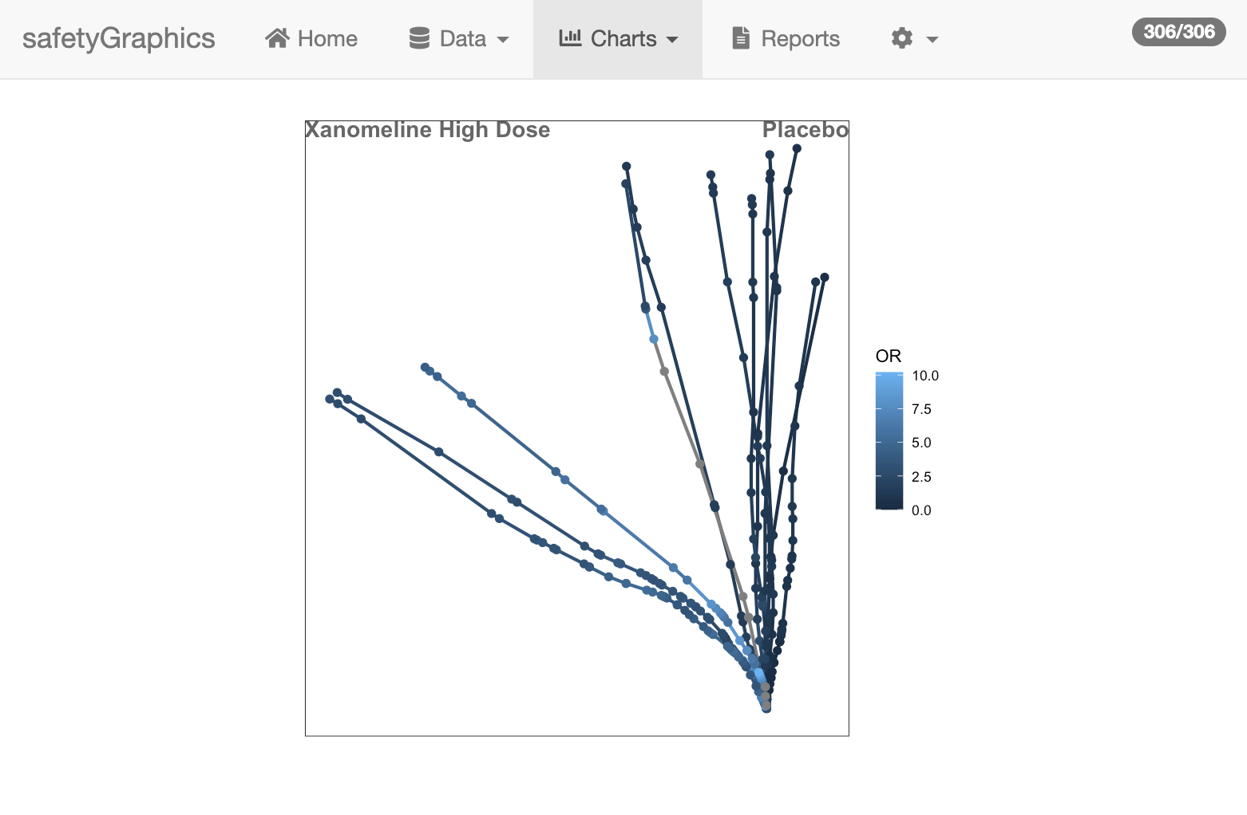
New Charts
Imported
{Tendril} Package
CRAN
Notes:
More Charts - Expand Chart Coverage to new safety domains
Qualification – Create Qualification Guidelines
Deployment – Run Pilots with interested stakeholders

Slide 48
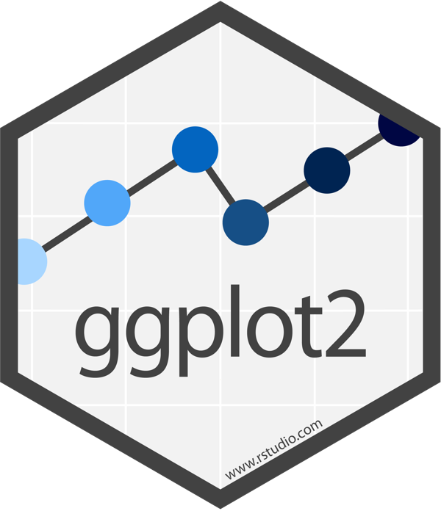
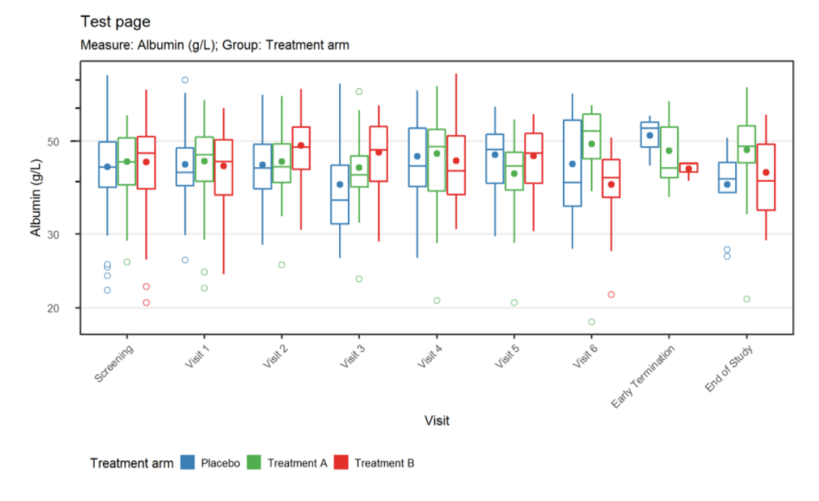
New Charts
Imported
Static
Notes:
More Charts - Expand Chart Coverage to new safety domains
Qualification – Create Qualification Guidelines
Deployment – Run Pilots with interested stakeholders

Slide 49
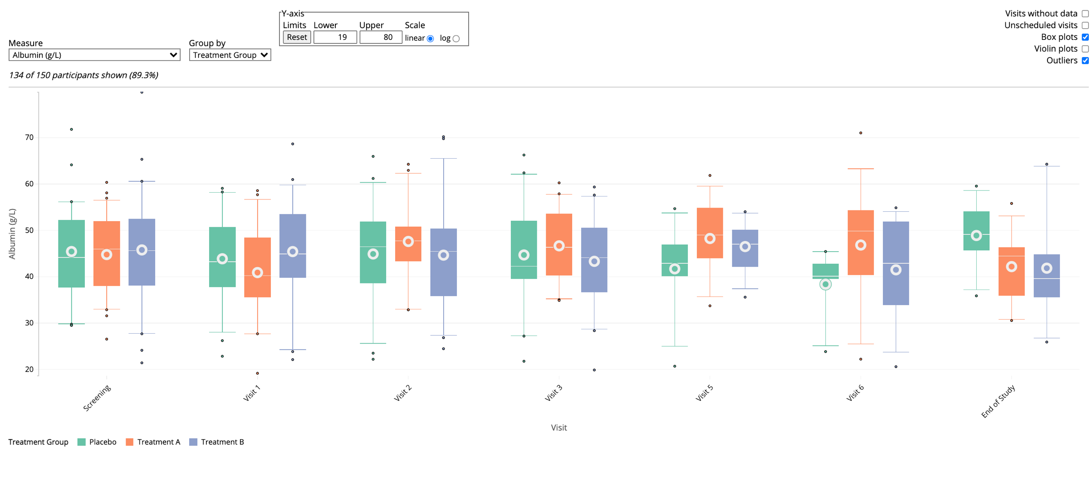
New Charts
Imported
Static
Notes:
More Charts - Expand Chart Coverage to new safety domains
Qualification – Create Qualification Guidelines
Deployment – Run Pilots with interested stakeholders

Slide 50
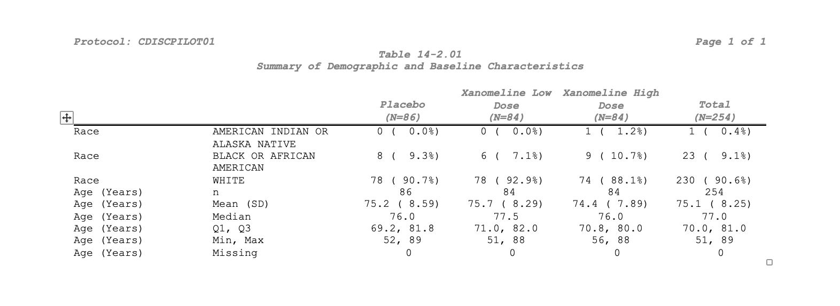
New Charts
Imported
Static
Tables
{pharmaRTF} Package
CRAN
Notes:
More Charts - Expand Chart Coverage to new safety domains
Qualification – Create Qualification Guidelines
Deployment – Run Pilots with interested stakeholders

Slide 51
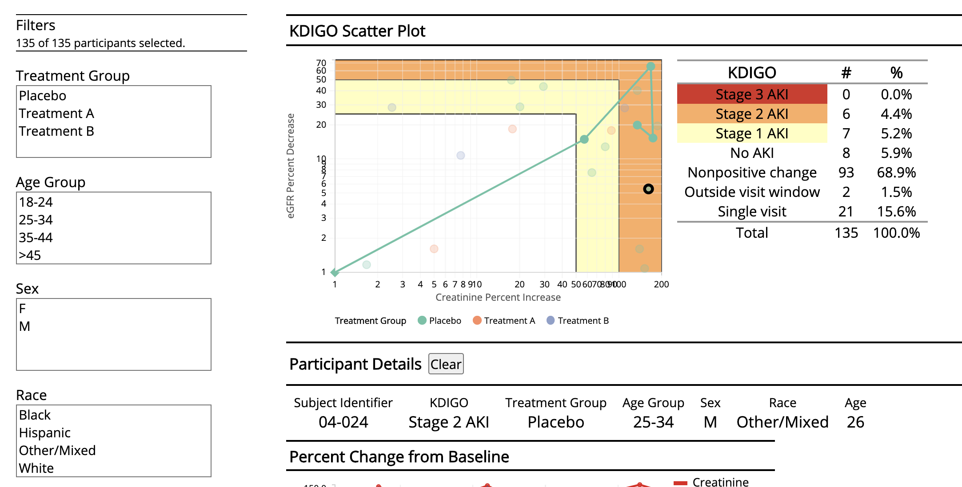
New Charts
Imported
Static
Tables
New Domains
nep-explorer prototype
GitHub
Notes:
More Charts - Expand Chart Coverage to new safety domains
Qualification – Create Qualification Guidelines
Deployment – Run Pilots with interested stakeholders

Slide 52
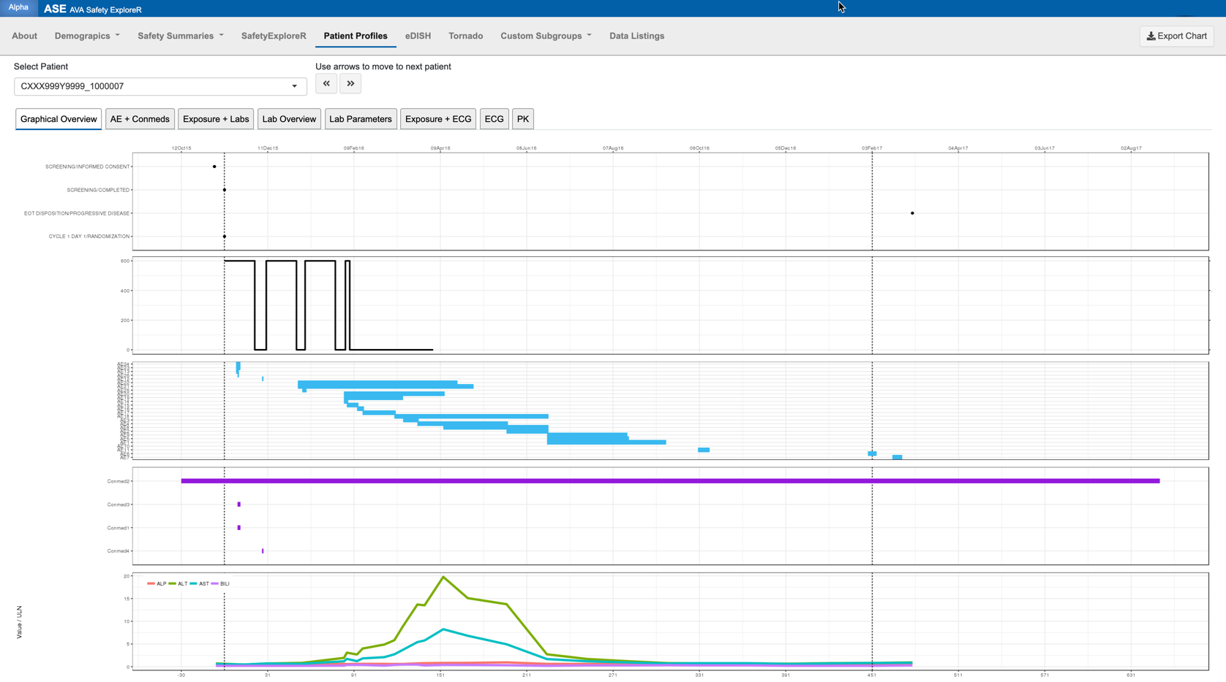
New Charts
Imported
Static
Tables
New Domains
Multiple Domains
Disposition
Treatment Exposure
AE
Conmeds
labs
Shiny Patient profile by Xiao Ni
GitHub
Notes:
More Charts - Expand Chart Coverage to new safety domains
Qualification – Create Qualification Guidelines
Deployment – Run Pilots with interested stakeholders

Slide 53
Qualification
Version 2 Quality Control Framework
Full code review
Extensive Documentation
Automated unit
User Acceptance Tests for charts
Standard workflow
Useful resources
R Validation Hub
{valtools}
{riskmetrics}
Notes:
More Charts - Expand Chart Coverage to new safety domains
Qualification – Create Qualification Guidelines
Deployment – Run Pilots with interested stakeholders

Slide 54
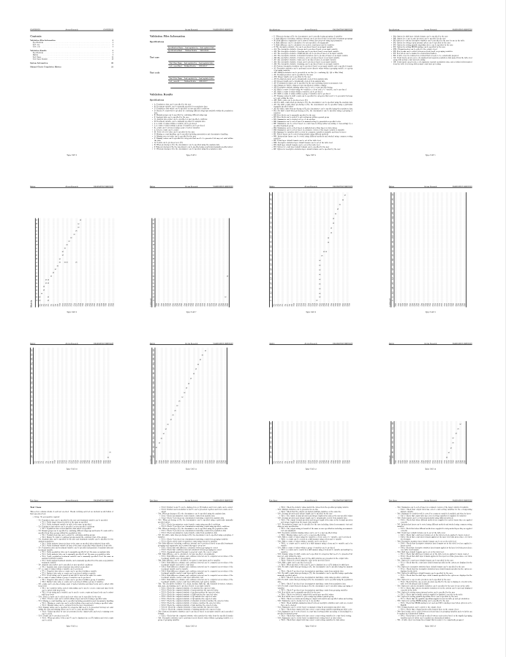

Qualification
Tplyr by Atorus
Repo - Qualification
Notes:
More Charts - Expand Chart Coverage to new safety domains
Qualification – Create Qualification Guidelines
Deployment – Run Pilots with interested stakeholders

Slide 55





Deployment
Security?
Cloud Infrastructure?
Big Data?
Pilot Deployments!
Notes:
More Charts - Expand Chart Coverage to new safety domains
Qualification – Create Qualification Guidelines
Deployment – Run Pilots with interested stakeholders

Slide 56
Future State
Secure Database
Validated Graphics

Slide 57
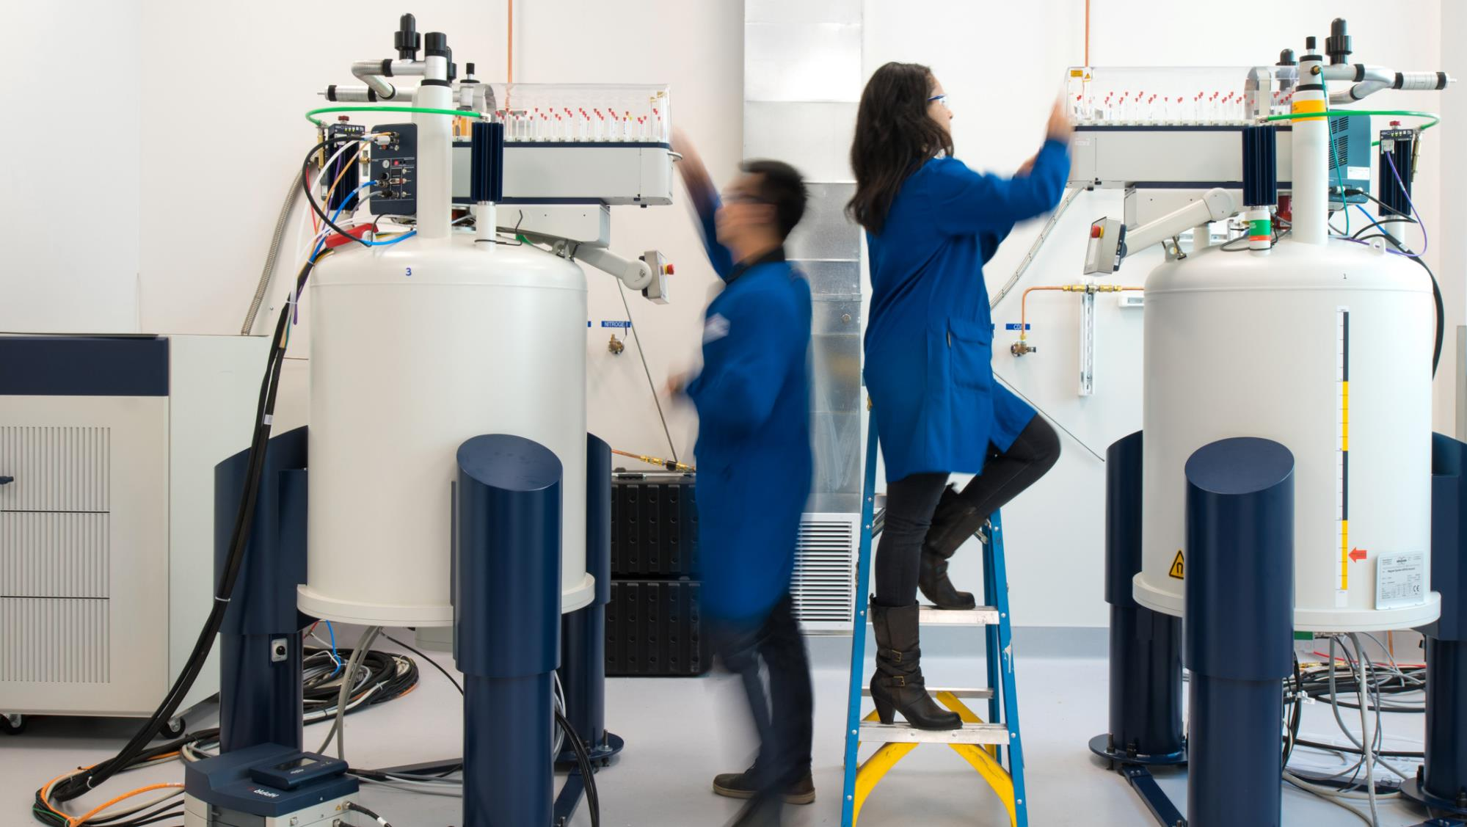
THANK YOU

